Slide 1
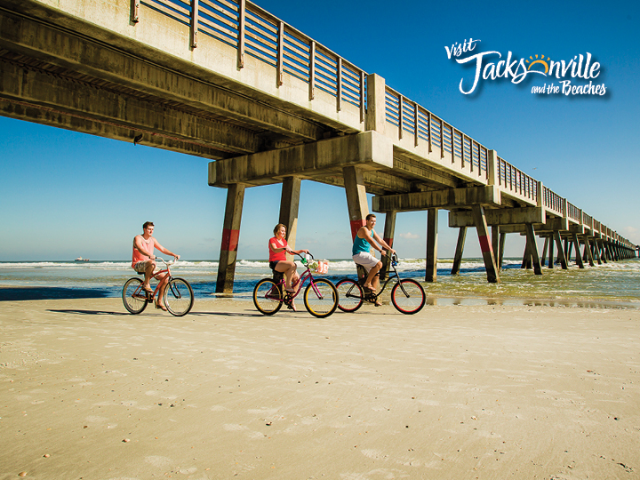
Marketing Grant Request

Slide 2
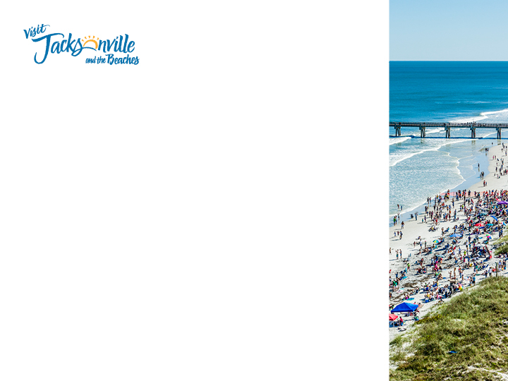
Marketing Initiative Funds Request
Requesting 10% of the annual bed tax collections, totaling $555,484 for 2014-2015
These funds will be used to strengthen and greatly increase our advertising reach
All of these funds are used to grow brand essence and destination awareness to key markets including:
Meeting Professionals Nationally
Southeast
Florida
I-95 Corridor (SC, NC, VA, NY)
11

Slide 3
2013-2014 Highlights
Overall, visitation numbers are the highest we have seen on record
Each month (March –June) have had the highest amounts of Room Revenue since Smith Travel began tracking Jacksonville/Duval County in 2004
May Hotel Revenue was over $32 million, that’s only a million less than revenue in February 2005 when we hosted the Super Bowl!
Total Revenue is up $17,850,129 Year to Date and demand is up 168,154 room nights
Overall, every month in 2014, Occupancy, Average Daily Rate and RevPar has been up.
Increases in Transient business:
Over a 12% increase in the last three years in transient business

Slide 4
Hotel RevPAR
Hotel Occupancy

Slide 5
Web Traffic
1,030,360 visits which is an increase of 42%
39% more visitors over last 12 months
Growth in specific markets –
62% increase from Florida
92% increase from Tallahassee
38% increase from Gainesville
35% increase from Tampa
38% increase from Georgia
29% increase from Atlanta
42% increase from Savannah
42% increase from South Carolina

Slide 6
Website Traffic

Slide 13
Continued focus to digital marketing which is more measureable and has been most successful in recent years
Grow focus on driving traffic to our website and pushing business to our local hotels and attractions
Selected print publications which provide long-term shelf life (annual guides) and strong circulation numbers
12

Slide 14
Leisure

Slide 15
Leisure Con’t

Slide 16
Meetings/Convention Ads

